Slide 1


5005CEM Lecture 4a: Visualisation of Two Variables
School of Computing, Mathematics and Data Science Coventry University
5005CEM Data Science 2022/23 Semester 2

Slide 2
Recap
Describe (summarise) dataset with numbers and graphs/plots.
Univariate data (one variable)
One categorical variable
One quantitative variable
Bivariate data (two variables)
Two categorical variables
Two quantitative variables
One categorical variable and one quantitative variable
Multivariate data (more than two variables)

Slide 3
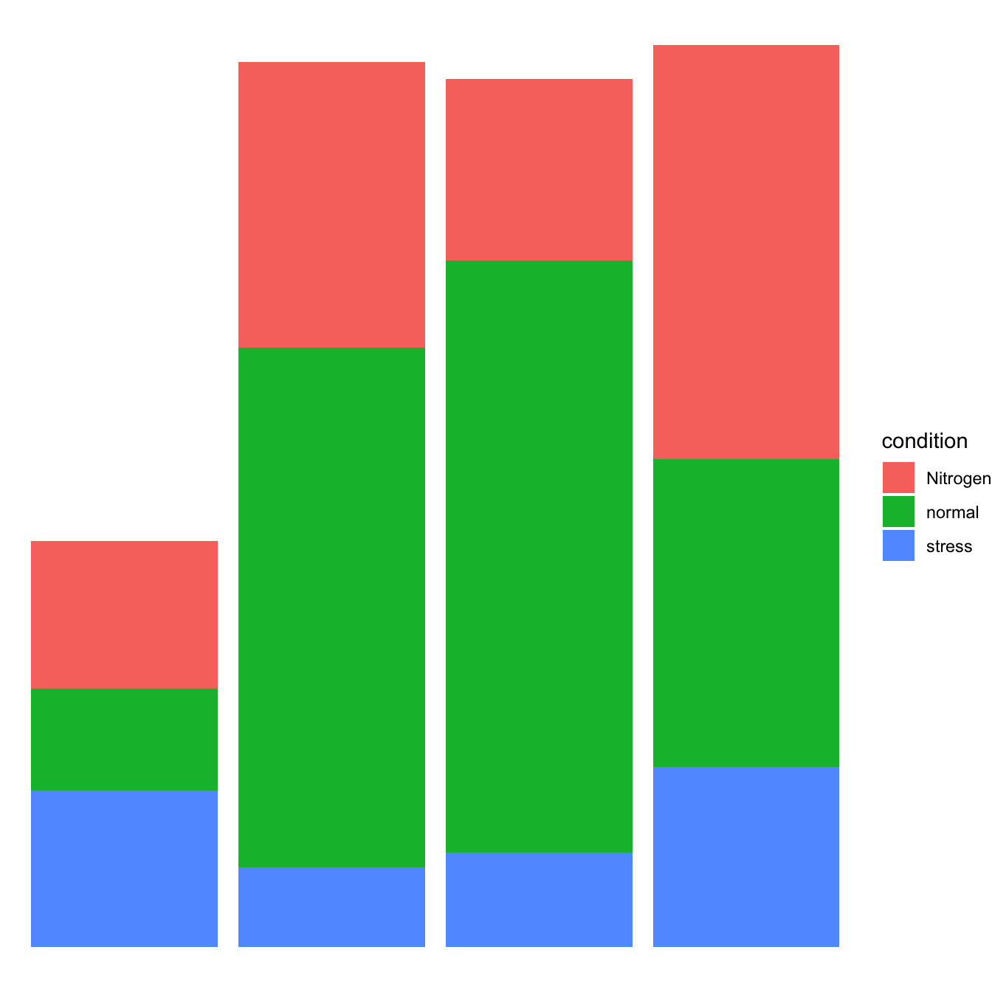
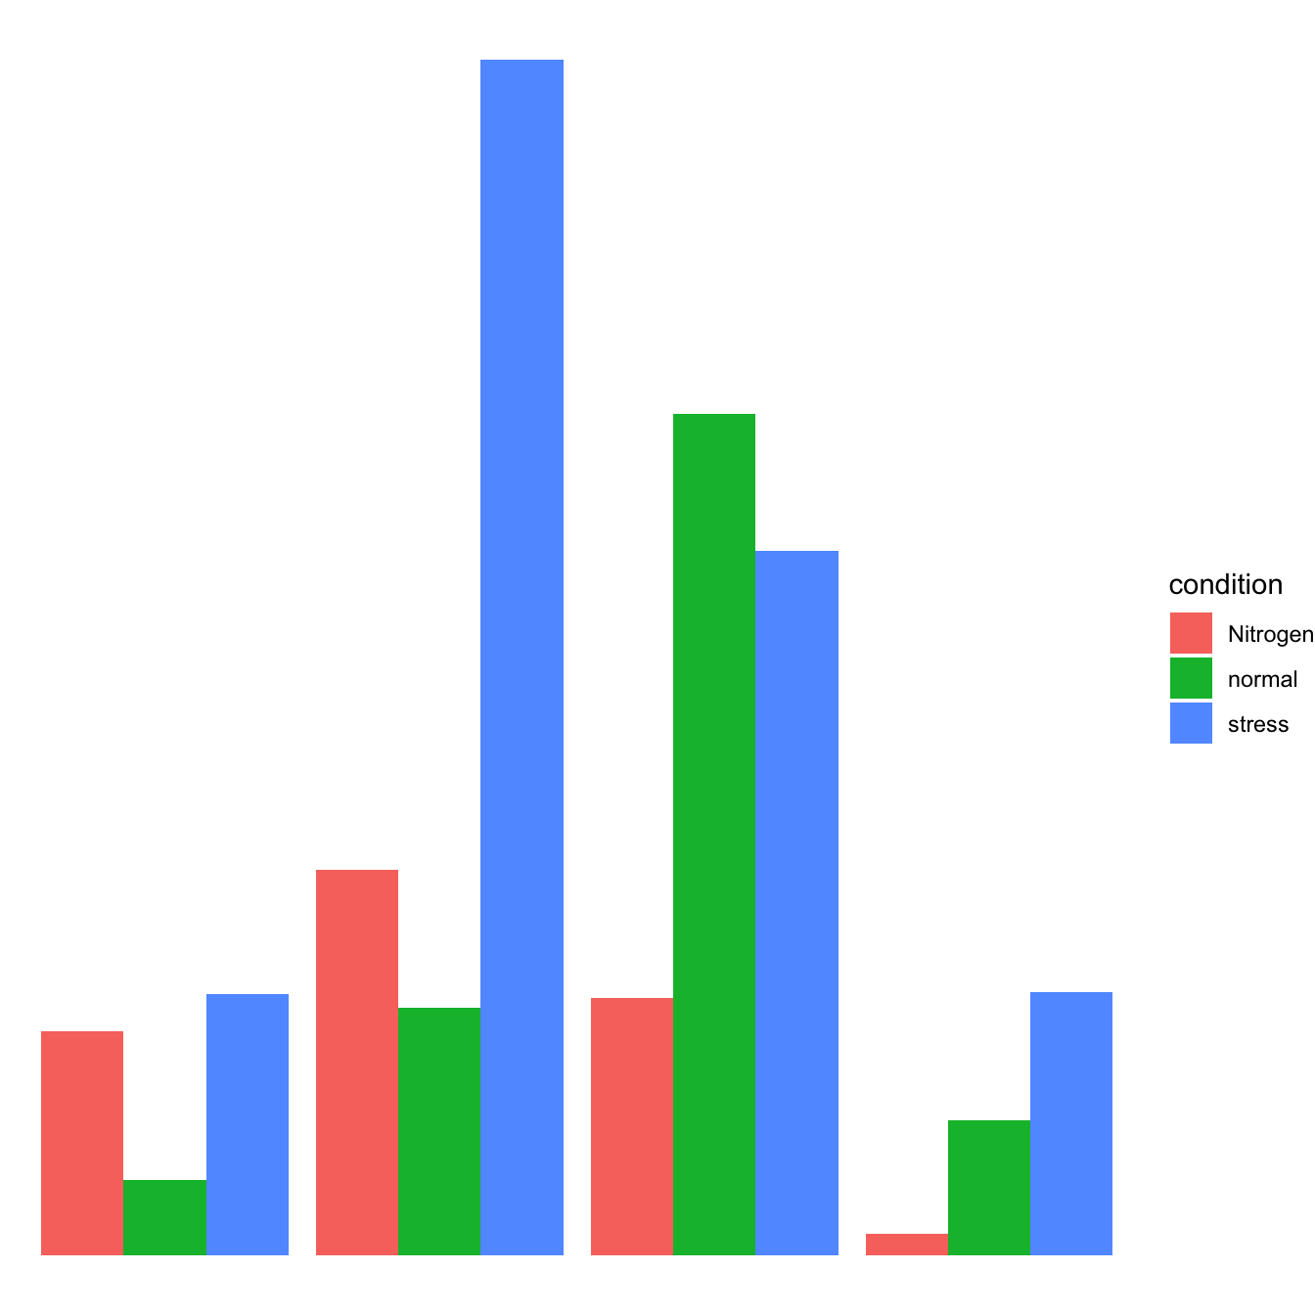
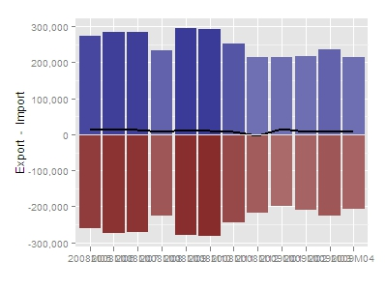
Visualisation of Two Categorical Variables
Two-way frequency table (called a contingency table)
Stacked barchart
Grouped barchart
Back-to-back barchart
 | Improve | Stable | Deteriorate
Small-business owners | 6 | 18 | 8
Medium-business owners | 3 | 12 | 13
Notes:
Example from: Clark and Randal (2/e) p281

Slide 4
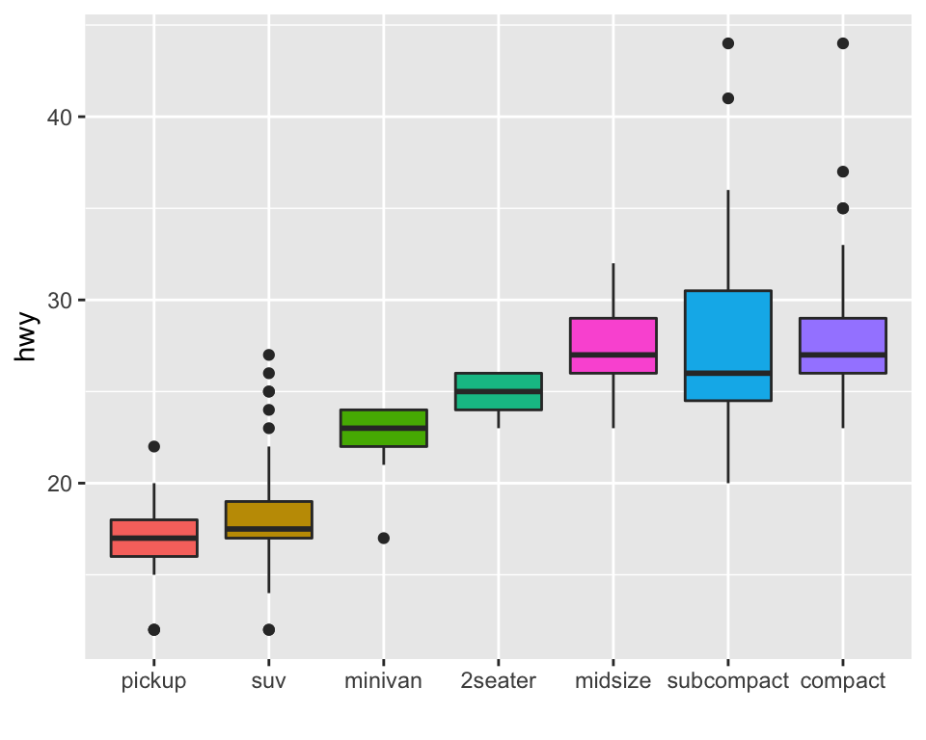
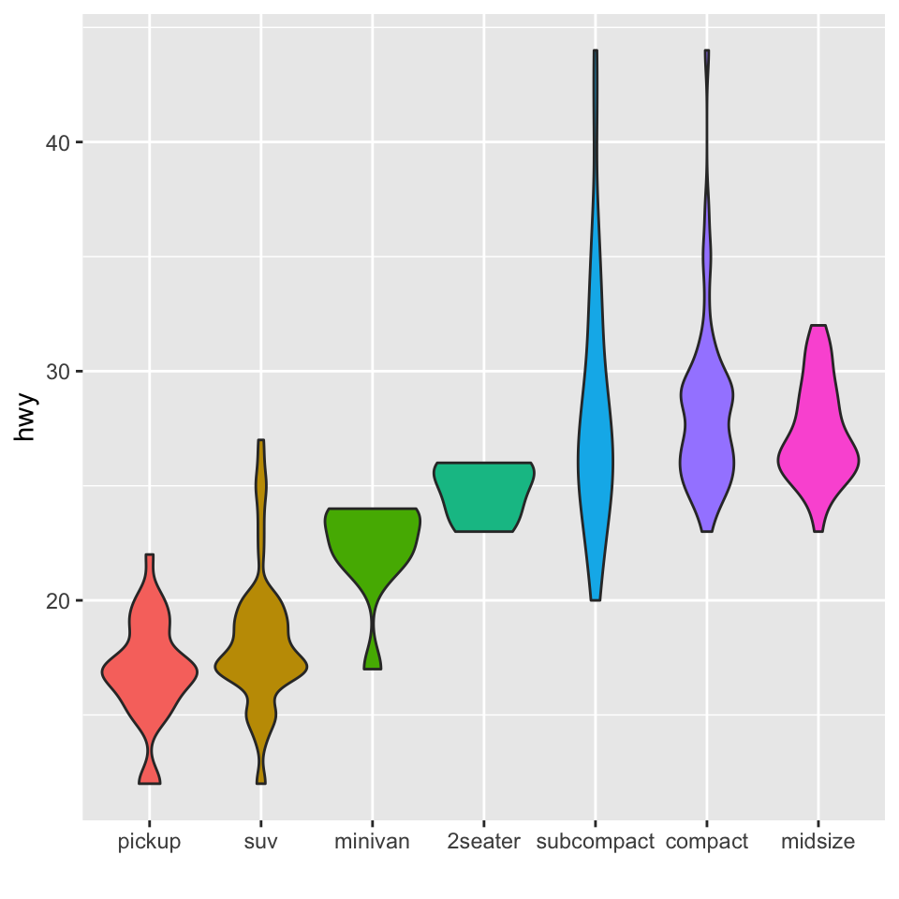
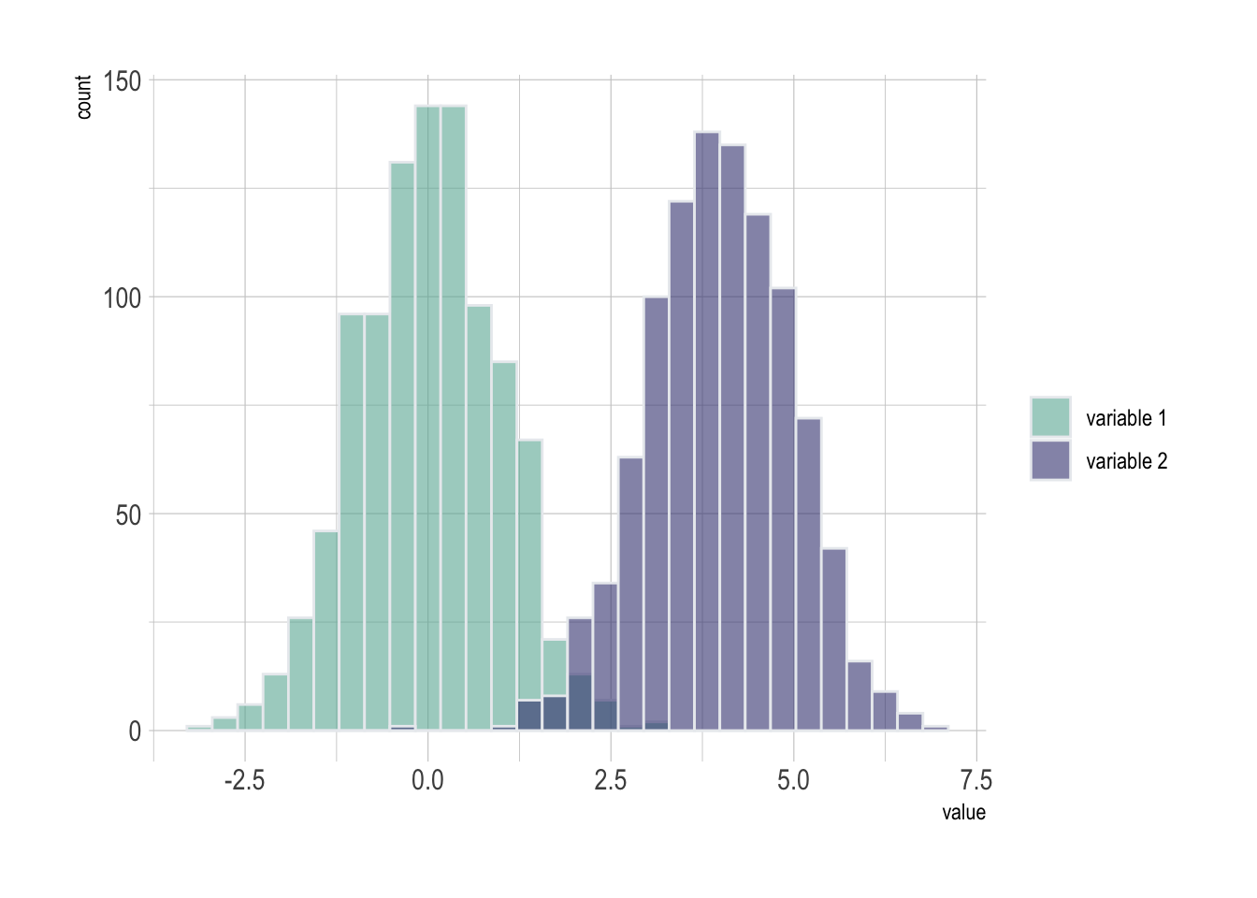
Visualisation of One Categorical and One Quantitative Variable
Compare the distributions of the quantitative variable for each value of the categorical variable
Side-by-side univariate plots (one for each category), e.g., boxplots, violin plots.
Histograms with groups (multiple histograms on the same axes).
Notes:
Reading: https://online.stat.psu.edu/stat200/lesson/3/3.3

Slide 5
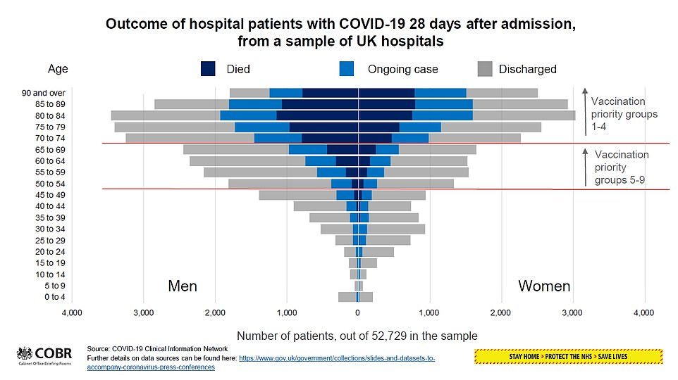
Daily Mail 4 Feb 2021
Notes:
Plot shows back-to-back stacked histograms.

Slide 6
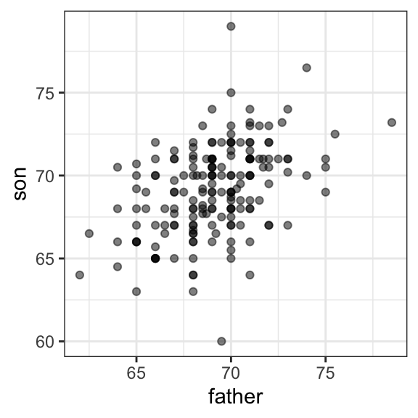
Visualisation of Two Quantitative Variables
Is height hereditary?
Sir Francis Galton observed that extremes in height passed to children, e.g., tall parents tend to have tall children.
However, distribution of parent heights approximately same as distribution of child heights.
How can these observations be reconciled?
Notes:
Reading: https://en.wikipedia.org/wiki/Regression_toward_the_mean#History

Slide 7
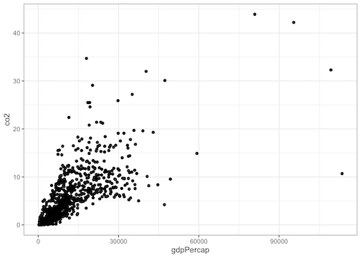
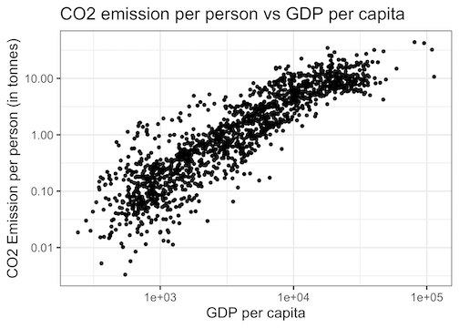
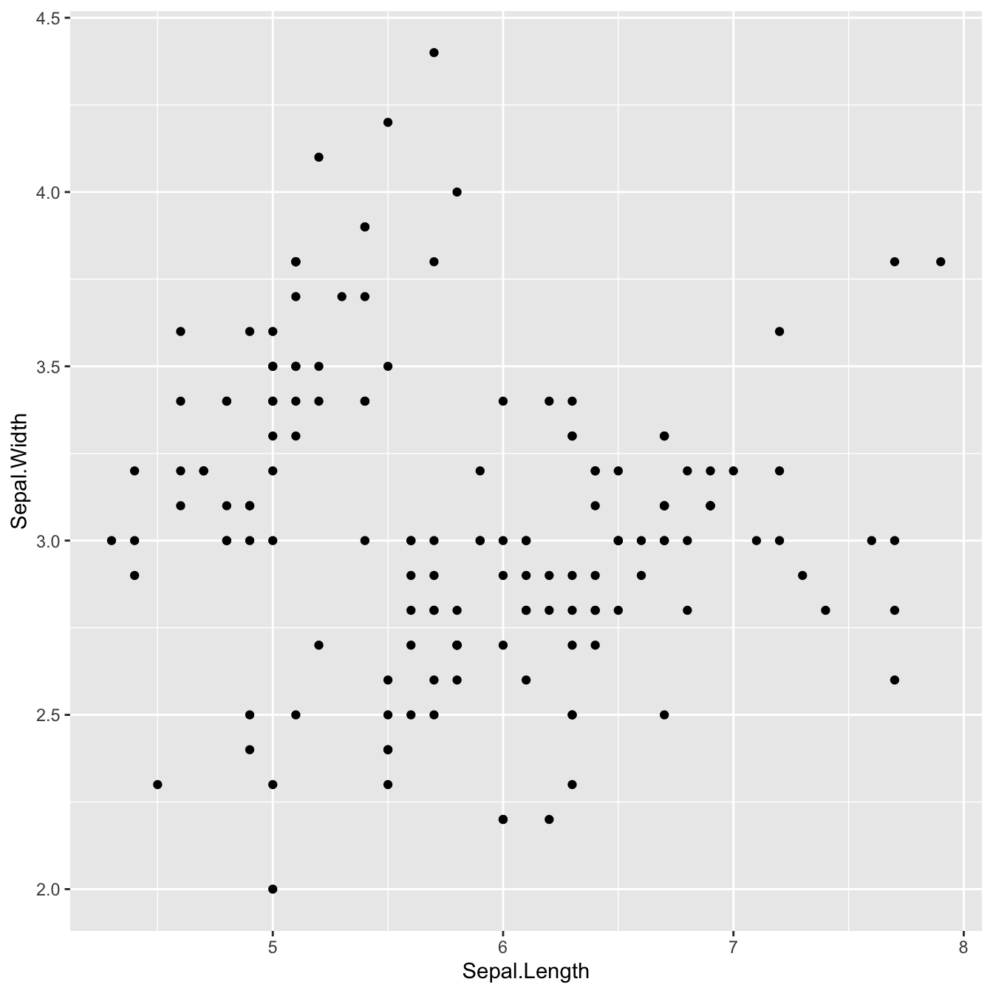
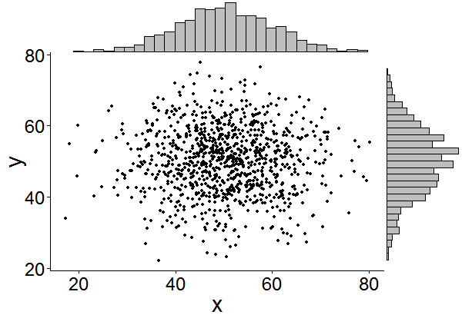
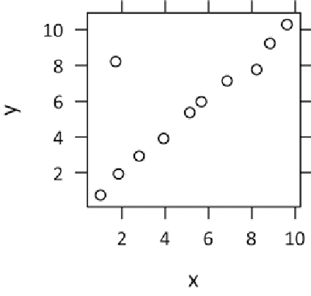
Visualisation of Two Quantitative Variables
Scatterplot (is there a relationship?)
Direction (positive or negative)
Form (linear or nonlinear)
Strength (weak, moderate, strong)
Bivariate outliers
Notes:
See: https://cmdlinetips.com/2019/11/9-tips-to-make-better-scatter-plots-with-ggplot2-in-r/

Slide 8
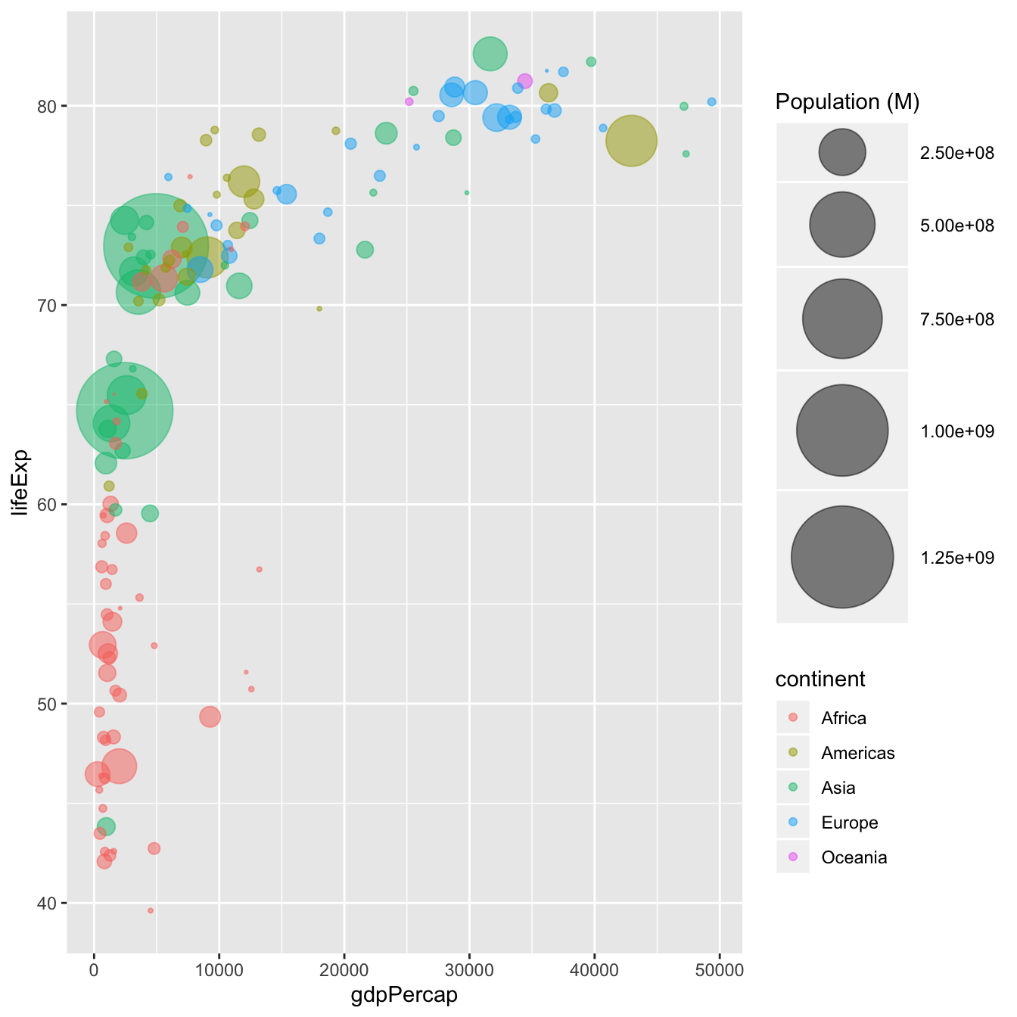
Visualisation of Multiple Variables
Scatterplot with groups
Use symbols and colours to represent categorical variables
Bubble plots
Use the size of the plotting symbol to represent a quantitative variable
Sometimes called a “weighted scatterplot”
Multivariate plots

Slide 9
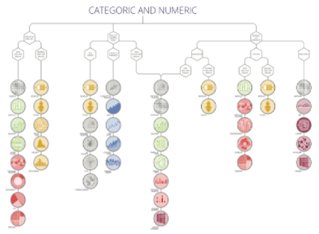
Graph Gallery
https://www.r-graph-gallery.com/
Recipes/examples using ggplot2 and the tidyverse
https://www.data-to-viz.com/
Decision tree leads to the most appropriate graph for your data.
Look at Categoric and Numeric.

Slide 10
Summary
Vital to classify variables as categorical or quantitative.
Select and interpret visual representations for two variables (depending on categorical or quantitative)
Two categorical: barcharts of different flavours
One cat/one quant: side-by-side quantitative plots
Two quantitative: scatterplot
Multiple variables: scatterplots and bubble plots of different flavours

Slide 11
Class Discussion Questions
Suppose you wish to visualise a dataset consisting of one quantitative variable and one categorical variable. What single plot would you recommend?

Slide 12
Class Discussion Questions
Suppose you wish to visualise a dataset consisting of two quantitative variables and two categorical variables. What single plot would you recommend? When there are a large number of observations/rows in a dataset, what is one weakness of the plot you recommend and how could you overcome it?

Slide 13
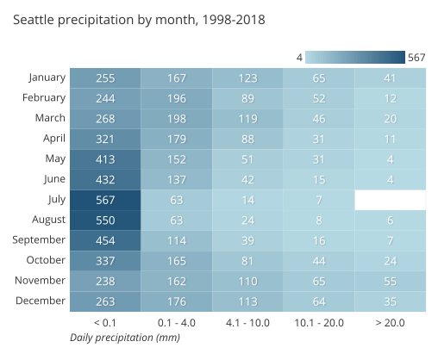
Class Discussion Questions
Use the example below to explain how a heatmap is related to a histogram.
Notes:
Image from: https://chartio.com/learn/charts/heatmap-complete-guide/

